Slide 1
Fun with incentives! Project Chicago and More
Philip daian, Yan Ji, Ari Juels
cornell tech / ic3
Projectchicago.io

Slide 2

GasToken: A Journey Through Blockchain Resource Arbitrage
GasToken slides shamelessly stolen from
Florian Tramèr
Stanford University
MIT Bitcoin Expo
18 March 2018

Slide 3


Imagine if…
Monday: It’s $4 for the cappuccino… and the transaction fee is $0.10.
Friday: It’s $4 for the cappuccino… and the transaction fee is $6.25.

Slide 4
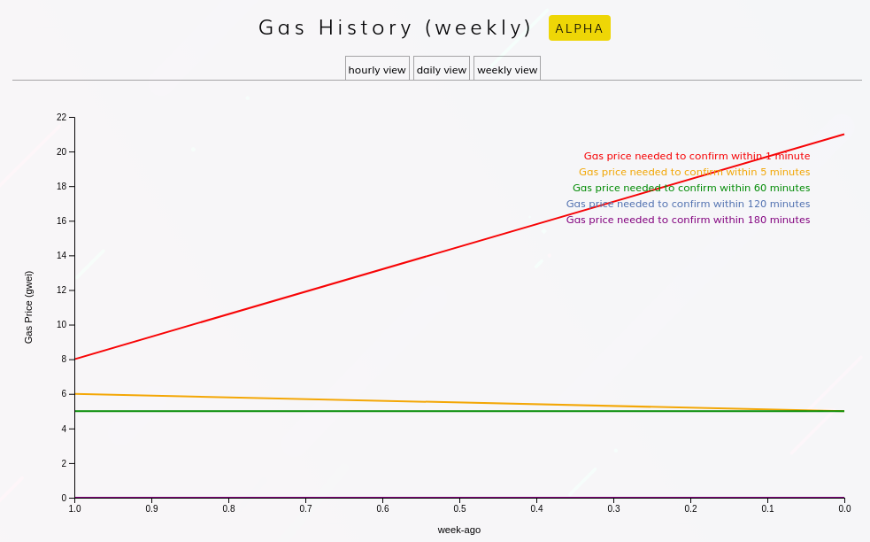

Slide 5
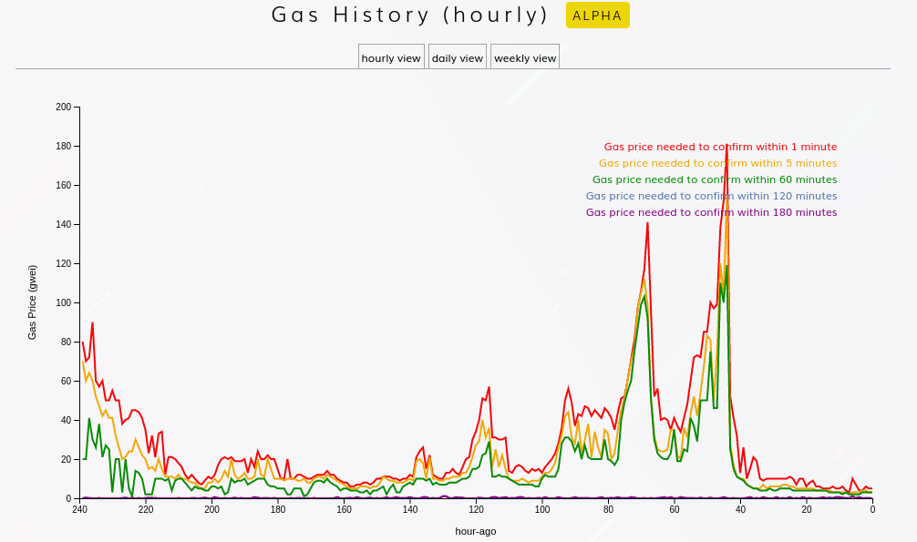

Slide 6
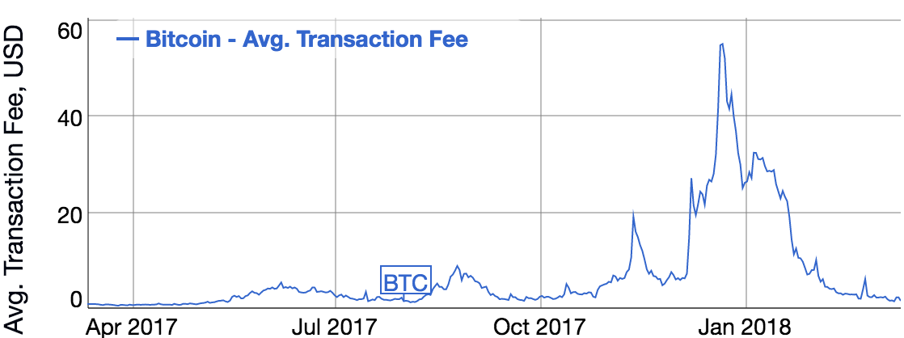
Same in Bitcoin…
source: bitinfocharts.com

Slide 7
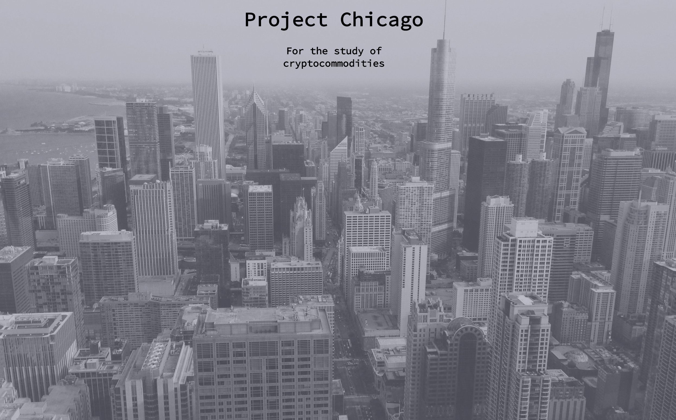


The big picture: Cryptocommodities
Blockchain transactions require a number of “raw” resources or commodities
Memory: block space, UTXO set, etc.
Computation: e.g., gas in Ethereum
Network: e.g. p2p relaying
How do we accurately price and freely trade these commodities (and their derivatives)?

Slide 8
Desiderata
What is a good market?

Slide 9
Desiderata
What is a good market?
(some lessons outside blockchains)

Slide 10

Desiderata
What is a good market?
(some lessons outside blockchains)

Slide 11
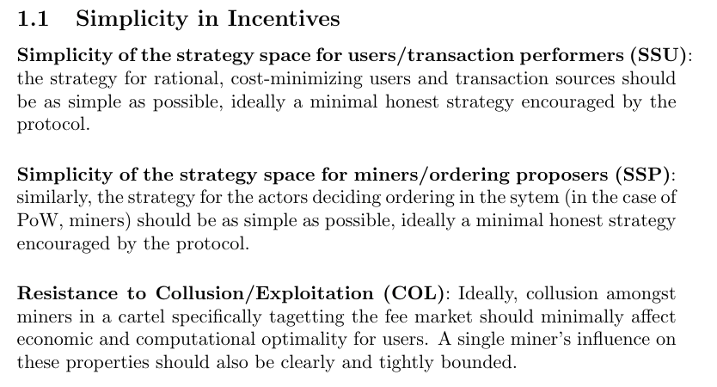
Desiderata

Slide 12
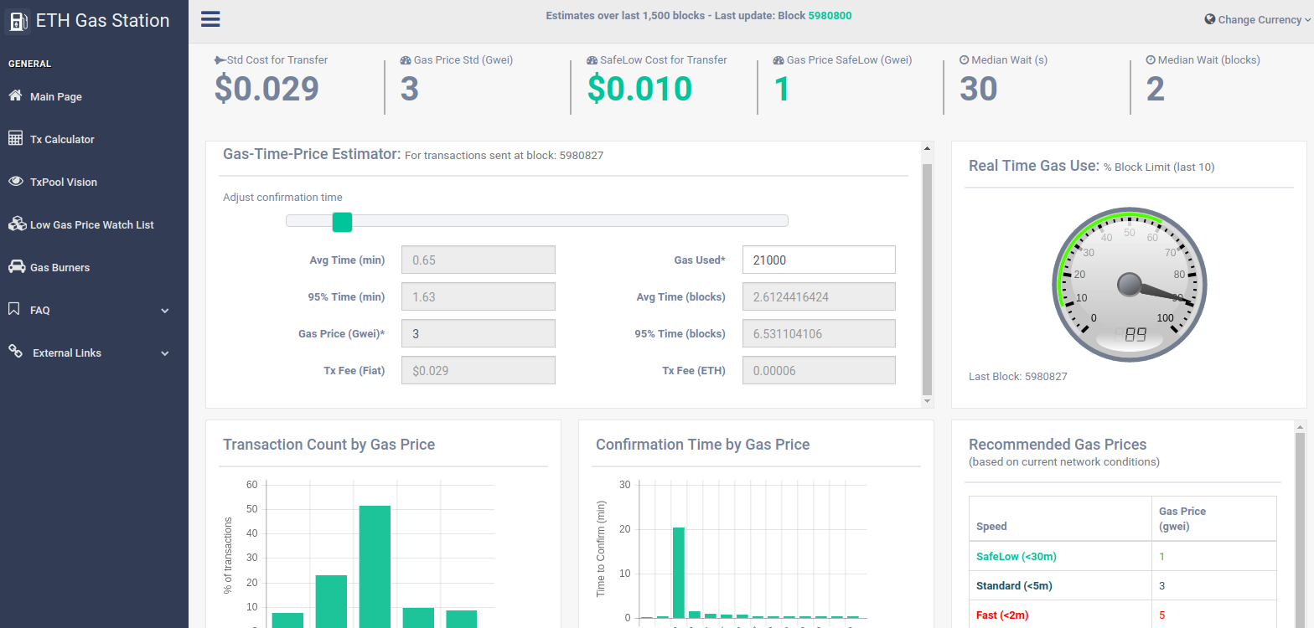
Desiderata

Slide 13
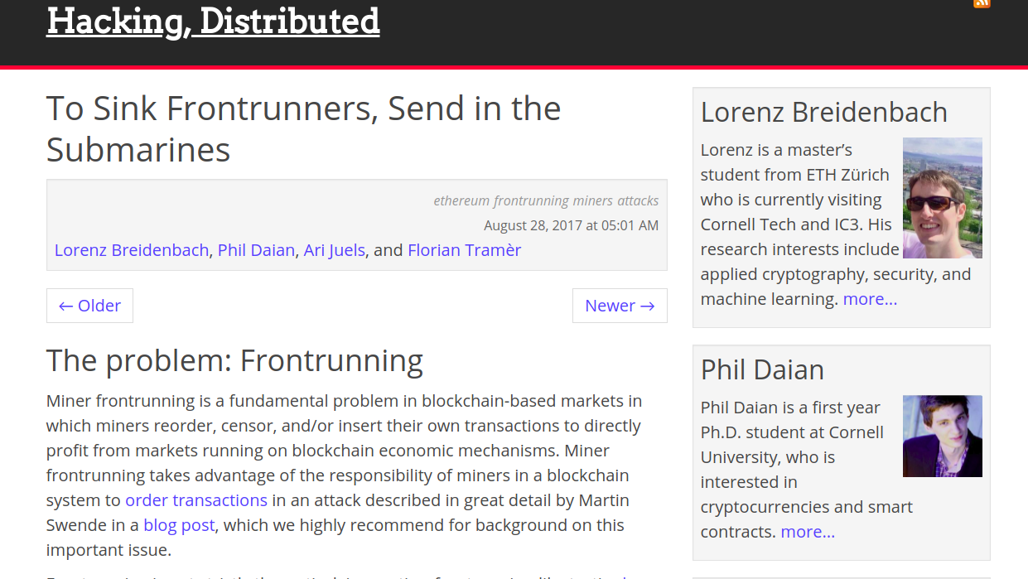
Desiderata

Slide 14
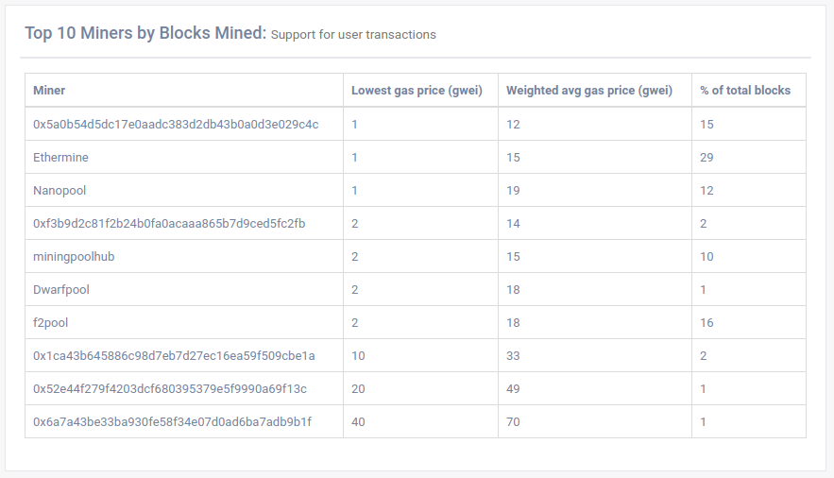
Desiderata

Slide 15
Desiderata

Slide 16
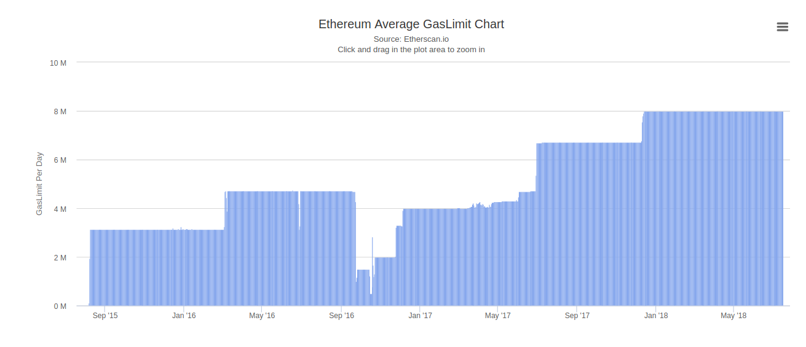
Desiderata

Slide 17
Desiderata

Slide 18
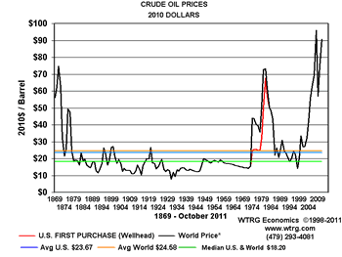
Desiderata

Slide 19
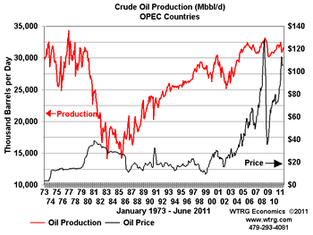
Desiderata

Slide 20
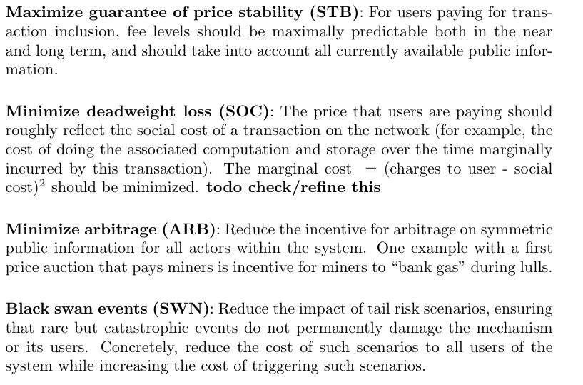
Desiderata

Slide 21
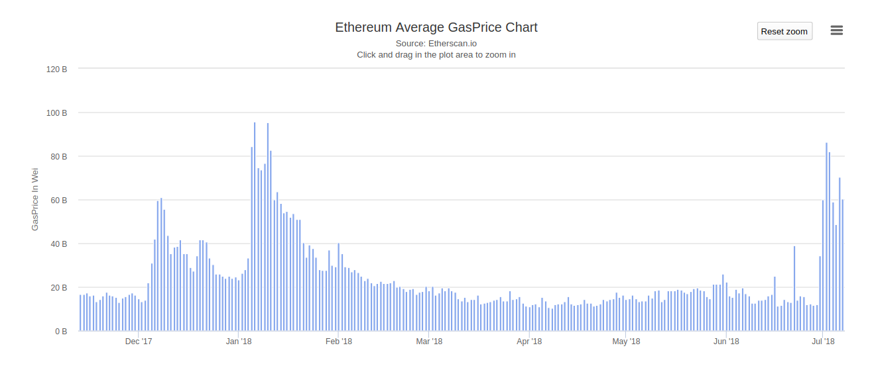
Desiderata

Slide 22
Desiderata

Slide 23

The issue with storage pricing
Blockchain state is (a priori) permanent
Smart contract storage, UTXO set, etc.
One time transaction fee ⇒ recurring & indefinite costs to network
Writing to state must be expensive to deter DOS attacks
Yet incentivize users to clean up…
E.g., many transactions in Bitcoin’s UTXO have no positive incentive to be spent
Why 20,000 gas for SSTORE?

Slide 24
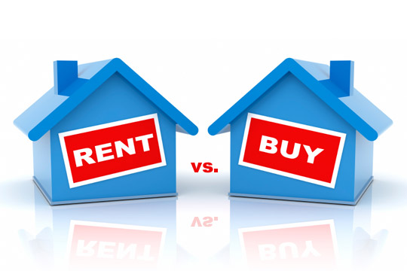
Storage Rent
EIP 35/87: Charge “rent” for contract storage
If rent unpaid, storage is removed from chain
Refund scheme could be removed entirely
Great idea but tricky execution
Developers must guard against storage loss
Entire contracts could disappear if unpaid

Slide 25
How do ordinary businesses handle volatility?
Stock up when prices are low!
Or buy financial instruments…
How do you “speculate on” or stockpile transaction fees?

Slide 26

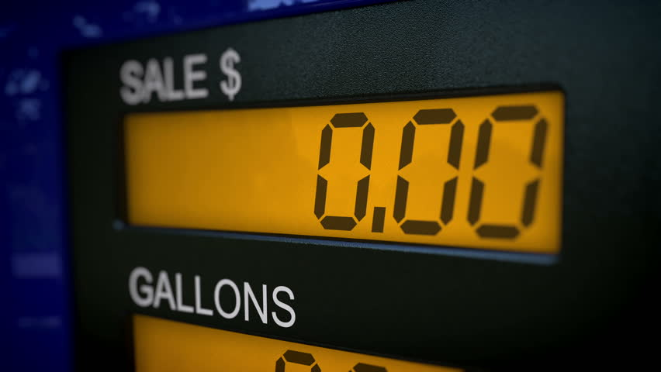
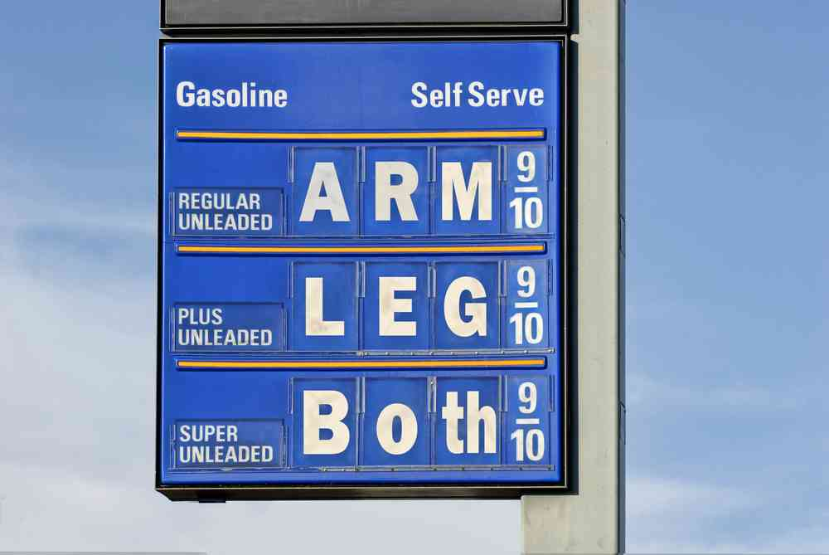
GasToken in a nutshell
To encourage state cleanup, Ethereum offers a gas refund for:
Released contract storage
Destroyed contracts
Write to state when gas price is low
Trade state slots as an ERC20 token
Release state when gas price is high
Refund pays up to half of transaction fee

Slide 27


An example
Regular
0
0
1
GWei
Store 10 words
Total Gas: 200,000
Price: $0.20
Regular
0
4
0
GWei
Free 10 words & Breed kitties
Total Gas: 250,000
Price: $9

Slide 28
An example
Regular
0
0
1
GWei
Store 10 words
Total Gas: 200,000
Price: $0.20
Free 10 words & breed kitties
Regular
0
4
0
GWei
refund
Total Gas: 250,000 – 100,000
Price: $9 $5

Slide 29
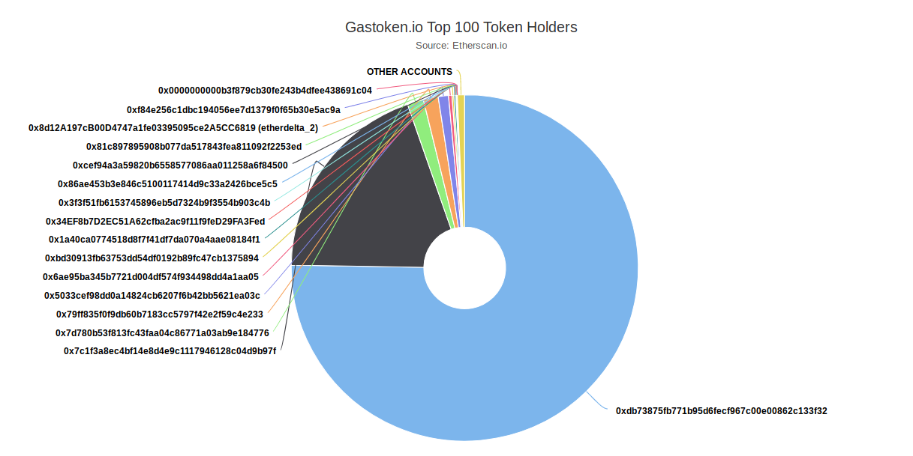
Mission Accomplished

Slide 30
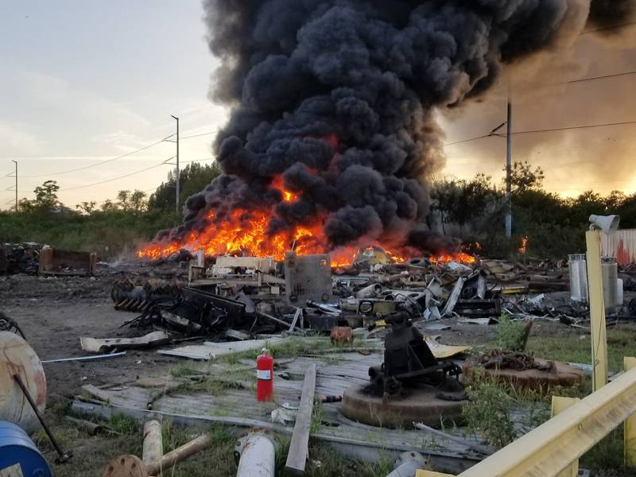

But.....

Slide 31
Desiderata
Tradeoffs?

Slide 32

THE DAIAN TRIANGLE
SOC
ARB
SWN

Slide 33


THE DAIAN TRIANGLE
SOC
ARB
SWN

Slide 34
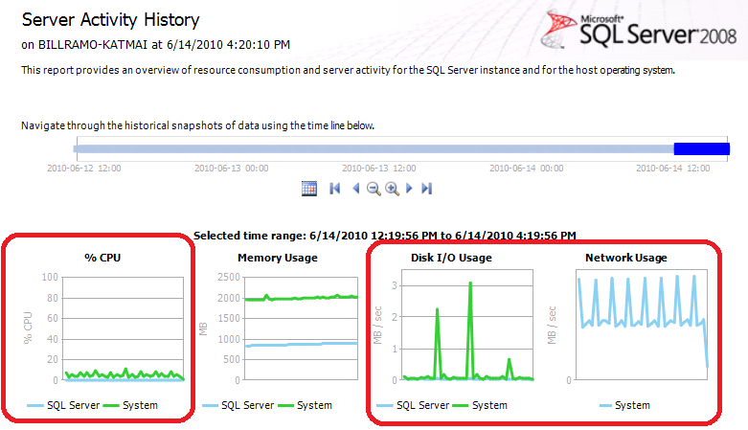
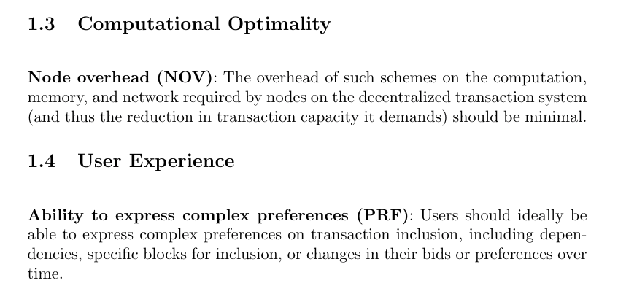

Desiderata

Slide 35
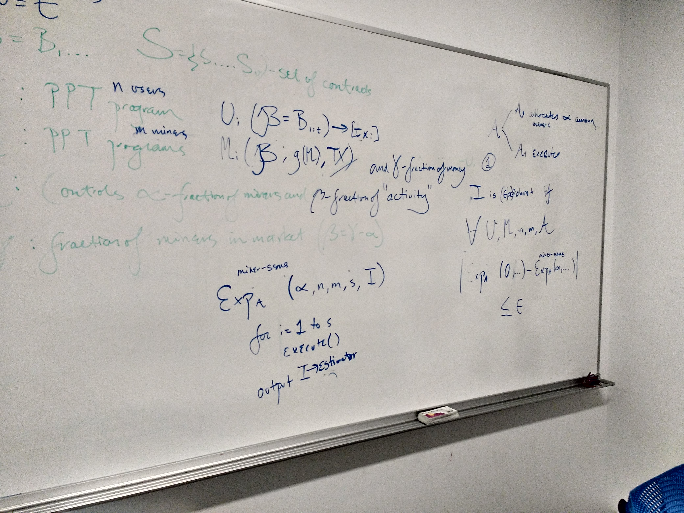
Desiderata

Slide 36
Several Alternatives
Existing model
Kth price auction
"Difficulty adjustment" style min-fee
Any of the above + futures
Hypothesis: Most efficient market will emerge out of band if not provided in-band, unless prevented by political capture.
To validate: Design secondary out of band systems for existing networks to encourage optimality and expose pathologies (GST/GST2/GSTBTC)

Slide 37
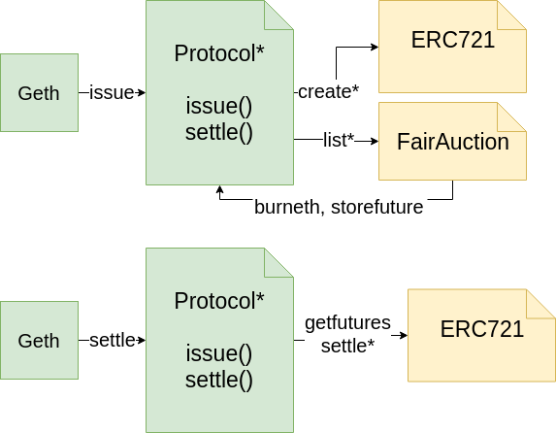

In-Protocol Futures
tx1
tx2
txn

Slide 38
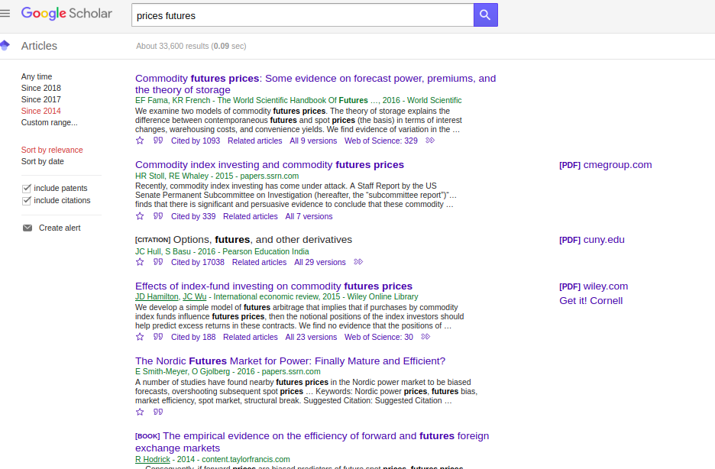
Related Work

Slide 39
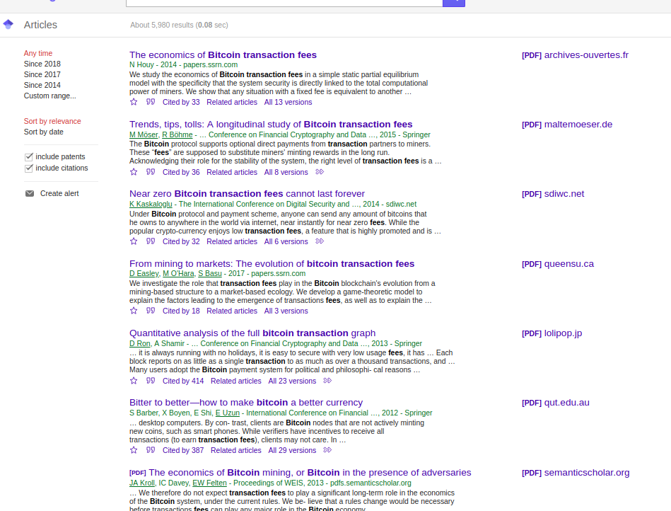
Related Work

Slide 40

Project Chicago: GasToken^BTC
More efficient transaction-fee derivatives
ERC721

Slide 41
Project Chicago: GasToken^BTC
More efficient transaction-fee derivatives
ERC721
address owner;
uint parent;
uint genome;
...

Slide 42

Project Chicago: GasToken^BTC
More efficient transaction-fee derivatives
ERC721

Slide 43
Project Chicago: GasToken^BTC
More efficient transaction-fee derivatives
ERC721
address maker;
address taker;
uint makerAmount;
uint takerAmount;
uint triggerPrice;
uint triggerHeight;
bool settled;
bool taken;

Slide 44


Project Chicago: beyond GasToken
More efficient transaction-fee derivatives
Bob: I’ll pay Alice’s transaction on April 1st
Avg. gas price is 5 gWei
Alice: Run my transaction
Bitcoin fee 200sat/byte
Transfer funds from Bob to Alice
Other cryptocommodities? Hashpower?
In-protocol futures
Could stable & efficient cryptocommodity markets be supported at the consensus level?

Slide 45
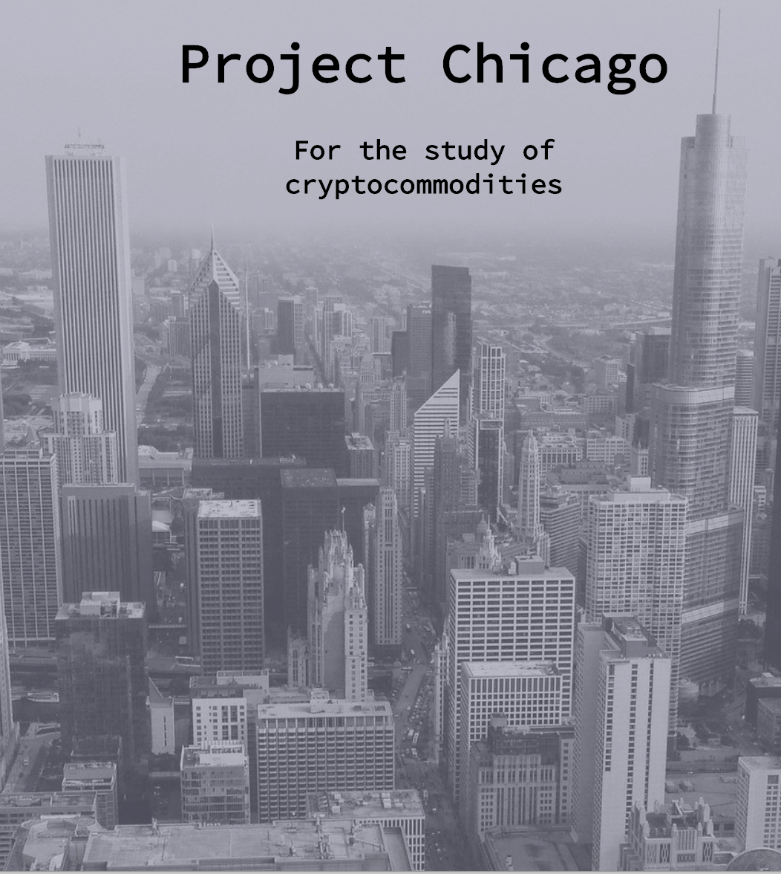
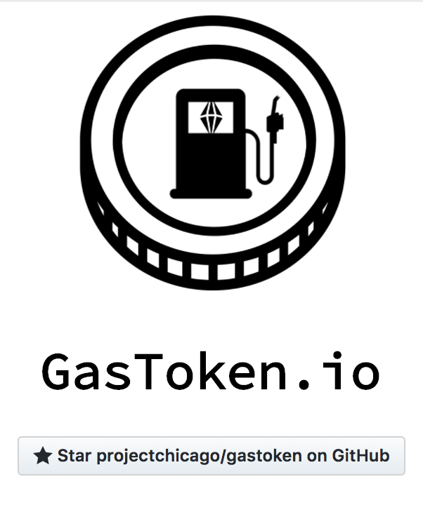
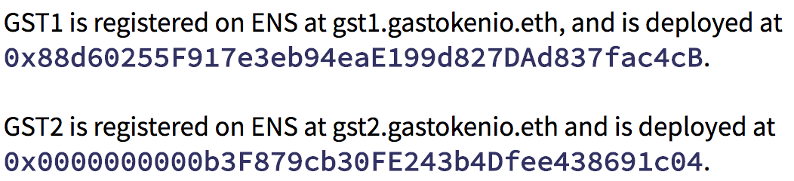
Learn More
https://gastoken.io
https://projectchicago.io

Slide 46

FAQ
Who “pays” for the refund?
Technically, the miner by only being paid for half the transaction cost
Really, whole network pays
Why wouldn’t miners blacklist GasToken then?
Ethereum is naturally “censorship resistant”
GasToken can increase transaction demand when gas prices are low
Is GST1/2 an investment vehicle / security / financial product?
No! We make absolutely no promises of any returns, profit…GasToken is not based on any currency, asset, or other financial product… We encourage users to expect zero further effort from its developers… it is likely that the developers of GasToken will advocate for changes to the network that render GasToken unusable.

